Slide 1

Efficient File Management Using Tree Data Structures for Hierarchical Storage Organization
CSA0315 - DATA STRUCTURES
Under the Guidance of:
Dr. Rajesh Kumar
Presented By: GURUPRASATH. S(192411270L)
S. Maruthu Pandi – 192511162

Slide 2


Project Overview
A File Management System is a software application that organizes files and folders using a Tree Data Structure. The tree structure represents the hierarchical relationship between directories and files, similar to how modern operating systems manage storage.
In this project:
Every folder is represented as a node.
The top-most folder is the root node.
Subfolders and files are stored as child nodes.
Users can create, search, delete, and move folders efficiently using tree operations.
This project demonstrates how a Tree Data Structure can solve real-world problems by providing fast navigation, organized storage, and scalable data management.

Slide 3
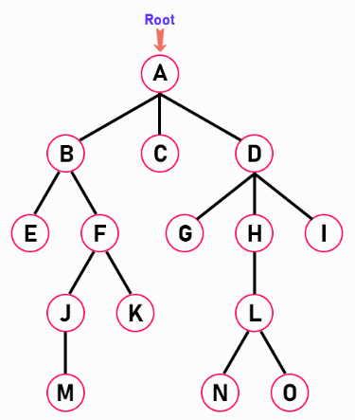
Introduction to Tree Data Structure
A Tree is a non-linear hierarchical data structure consisting of nodes connected by edges.
Unlike arrays or linked lists, trees store data in a parent-child relationship.
Main Components
Root Node
Parent Node
Child Node
Leaf Node
Internal Node
Edge
Subtree

Slide 4
Problem Statement
Managing thousands of files using a simple list becomes inefficient
Searching takes more time.
Navigation becomes confusing.
Folder relationships are difficult to maintain.
Storage organization becomes poor.
A hierarchical Tree Structure solves these issues by providing an organized and scalable method of storing files and folders.

Slide 5
Objectives
Apply Tree Data Structure in a real-world application.
Organize folders hierarchically.
Perform efficient insertion and deletion.
Implement searching using tree traversal.
Improve navigation efficiency.
Demonstrate practical use of non-linear data structures.

Slide 6
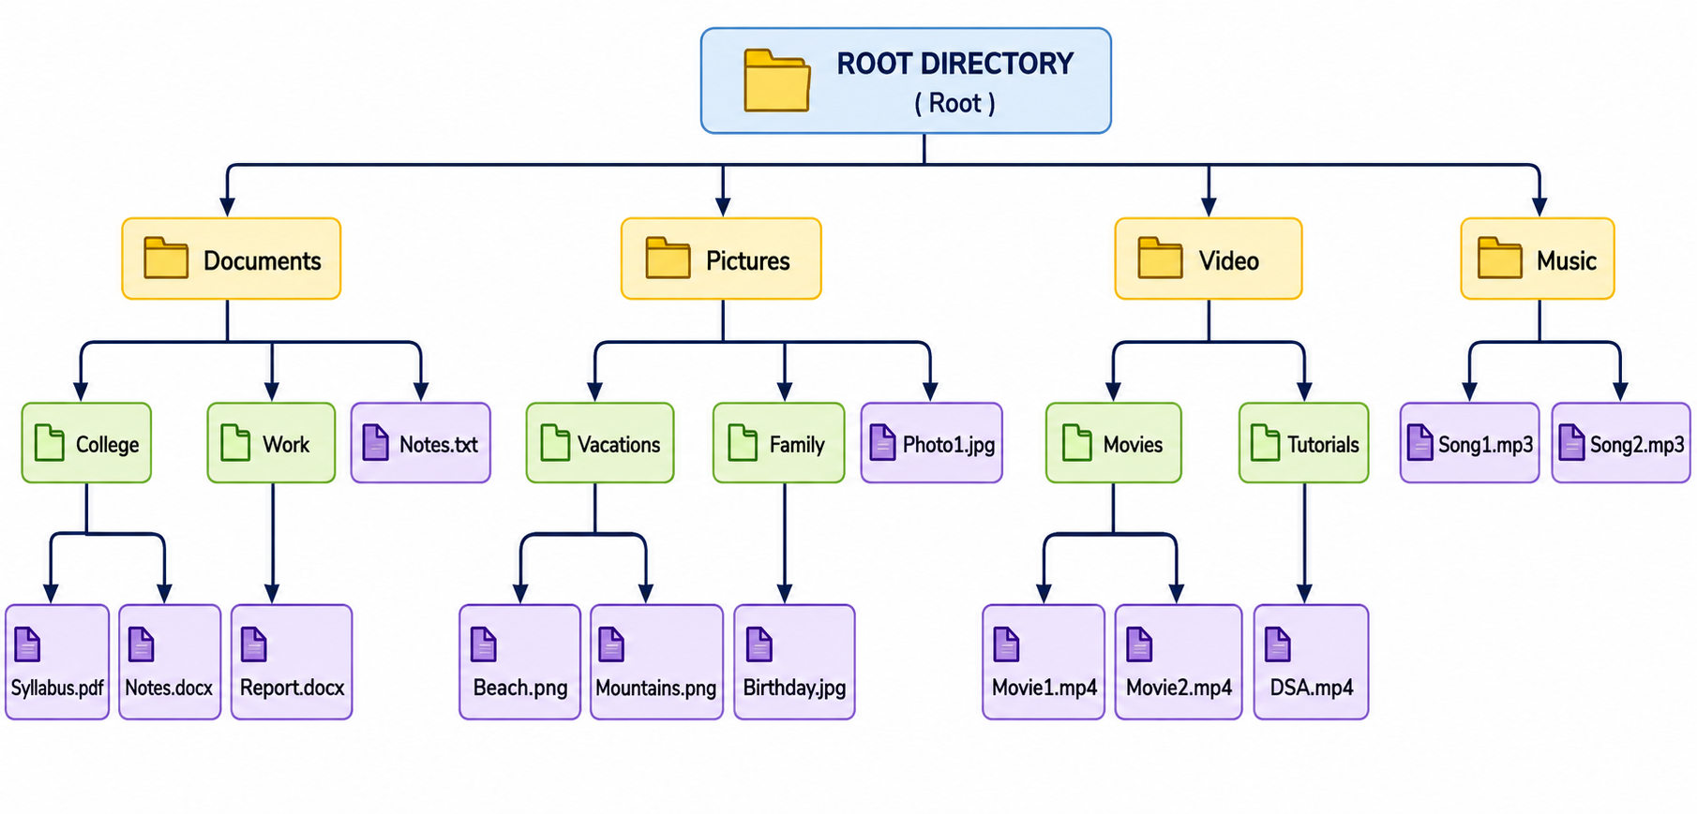
Project Architecture

Slide 7
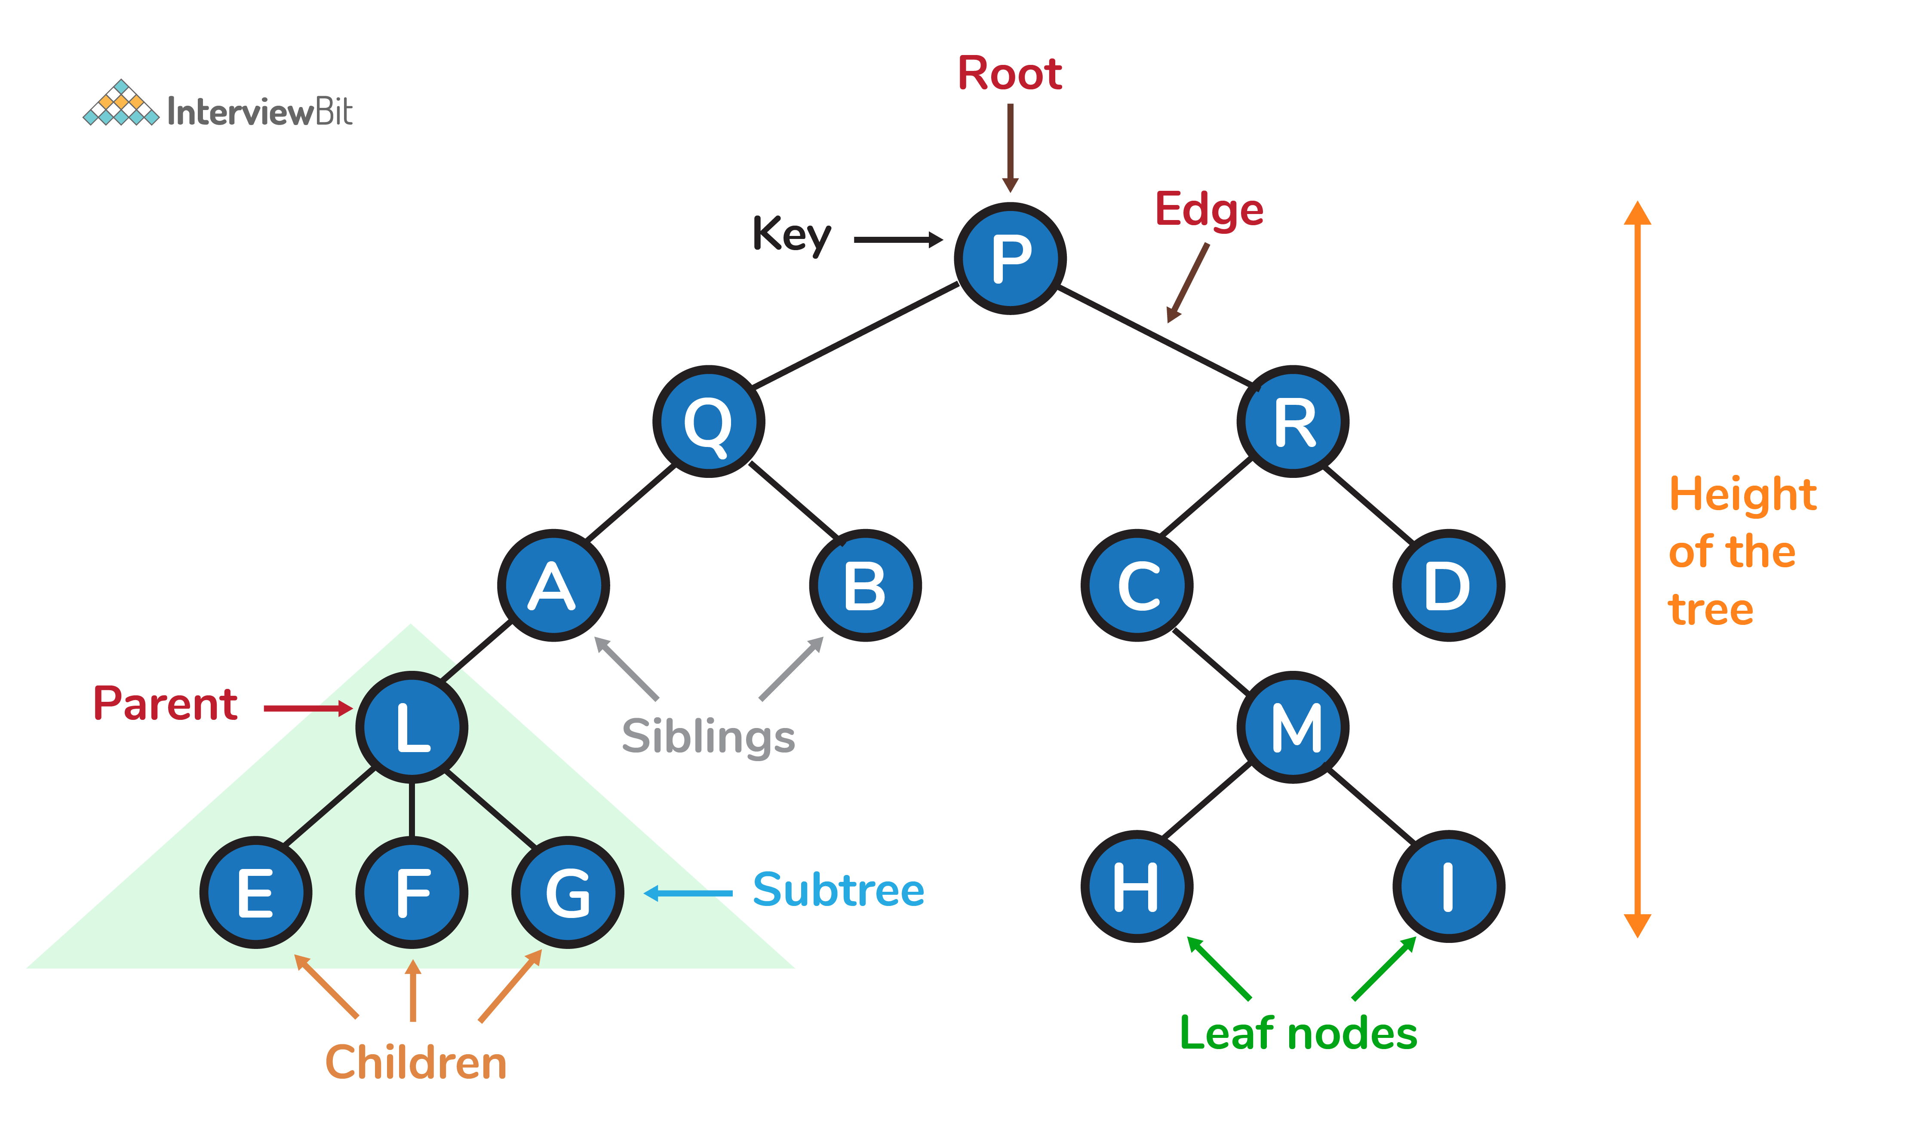
Tree Structure Representation
Root represents the main directory.
Every folder becomes a parent node.
Files are stored as child nodes.
The hierarchy allows efficient navigation

Slide 8
CODE FOR NODE
Every file and folder is represented by the same struct — a boolean flag tells operations whether it's a leaf (file) or can have children (folder).
#include<stdio.h>
#include<malloc.h>
#define NAME_LEN 50
typedef struct Node {
char name[NAME_LEN]; // file or folder name
int isFile; // 1 = file, 0 = folder
struct Node *firstChild; // first child (folder only)
struct Node *nextSibling; // next node at same level
} Node;
Node* createNode(char *name, int isFile) {
Node *n = (Node*) malloc(sizeof(Node));
strcpy(n->name, name);
n->isFile = isFile;
n->firstChild = n->nextSibling = NULL;
return n;
}
7

Slide 9
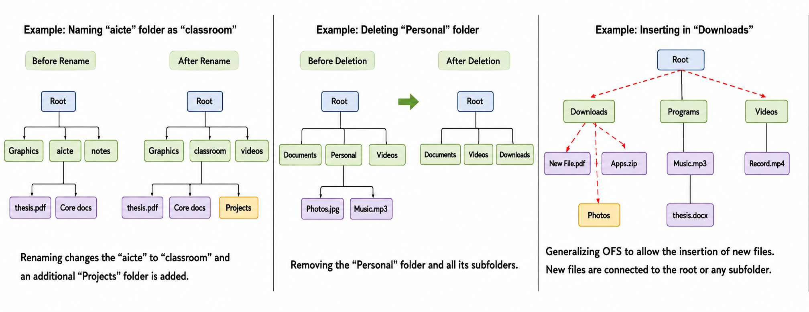
Operations Performed
1.Insertion 2.Deletion 3.Searching
4.Traversal (User must visit every node at least once)
Preorder Traversal (Root – Left Node –Right Node )
Post order Traversal (Left Node –Right Node –Root)
In Order Traversal (Left Node –Root –Right Node )

Slide 10
Code — Display Function
Code — Display Function
void displayTree(Node *node, int depth) {
if (node == NULL) return;
for (int i = 0; i < depth; i++)
printf(" "); // indent per depth level
printf("%s%s\n", node->name, node->isFile ? "" : "/");
displayTree(node->firstChild, depth + 1); // go deeper
displayTree(node->nextSibling, depth); // go across
}
12

Slide 11
Code — Search Function
Node* searchNode(Node *node, char *target) {
if (node == NULL) return NULL;
if (strcmp(node->name, target) == 0)
return node; // match found
Node *found = searchNode(node->firstChild, target);
if (found != NULL) return found; // found inside subtree
return searchNode(node->nextSibling, target); // try next sibling
}
14

Slide 12
Code — Delete Function
void freeTree(Node *node) {
if (node == NULL) return;
freeTree(node->firstChild); // free children first
freeTree(node->nextSibling); // then siblings
free(node); // finally, this node
}
// Caller: relink the parent before freeing the target subtree
void deleteNode(Node *parent, char *name) {
Node *cur = parent->firstChild, *prev = NULL;
while (cur && strcmp(cur->name, name) != 0) {
prev = cur; cur = cur->nextSibling;
}
if (!cur) return; // not found
if (prev) prev->nextSibling = cur->nextSibling;
else parent->firstChild = cur->nextSibling;
cur->nextSibling = NULL;
freeTree(cur);
}
16

Slide 13
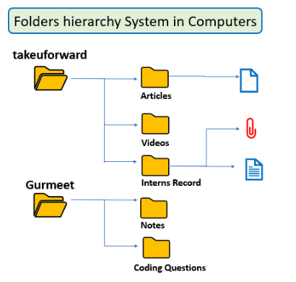
Working Process
User opens the application.
Root folder is created.
New folders are inserted as child nodes.
Files are stored inside folders.
Tree traversal displays the hierarchy.
Search operations locate files efficiently

Slide 14
DEMONSTRATION
Sample Program Output
A console-menu driven session: the user creates a few folders and files, then displays the tree.
===== Smart File Management System =====
1. Create 2. Search 3. Display 4. Delete 5. Exit
Enter choice: 1
Parent name: root | New name: Docs | Type (0=folder): 0
Docs created under root
Enter choice: 1
Parent name: Docs | New name: resume.docx | Type: 1
resume.docx created under Docs
Enter choice: 3
root/
Docs/
resume.docx
Music/
song.mp3
17

Slide 15

Advantages
Hierarchical organization
Faster navigation
Easy searching
Dynamic insertion
Efficient deletion
Better scalability
Reduced storage complexity
Easy maintenance

Slide 16
Conclusion
The File Management System Using Tree Data Structure demonstrates how a non-linear data structure can be applied to solve a practical problem.
By organizing folders and files as tree nodes, the system enables efficient insertion, deletion, searching, and traversal.
The project highlights the importance of trees in managing hierarchical data and showcases their applications in modern operating systems and cloud storage platforms.

Slide 17
References
Cormen, T. H., Leiserson, C. E., Rivest, R. L., & Stein, C. (2022). Introduction to algorithms (4th ed.). MIT Press.
Goodrich, M. T., Tamassia, R., & Goldwasser, M. H. (2014). Data structures and algorithms in Python. John Wiley & Sons.
Horowitz, E., Sahni, S., & Anderson-Freed, S. (2008). Fundamentals of data structures in C (2nd ed.). Universities Press.
Lafore, R. (2002). Data structures and algorithms in Java (2nd ed.). Sams Publishing.
Microsoft. (2025). File systems. https://learn.microsoft.com/windows/win32/fileio/file-systems
Oracle. (2025). Java documentation. https://docs.oracle.com/en/java/
Programiz. (2025). Tree data structure. https://www.programiz.com/dsa/trees
Sahni, S. (2005). Data structures, algorithms, and applications in C++ (2nd ed.). Universities Press.
Weiss, M. A. (2014). Data structures and algorithm analysis in C++ (4th ed.). Pearson.

Slide 18


